Slide 1



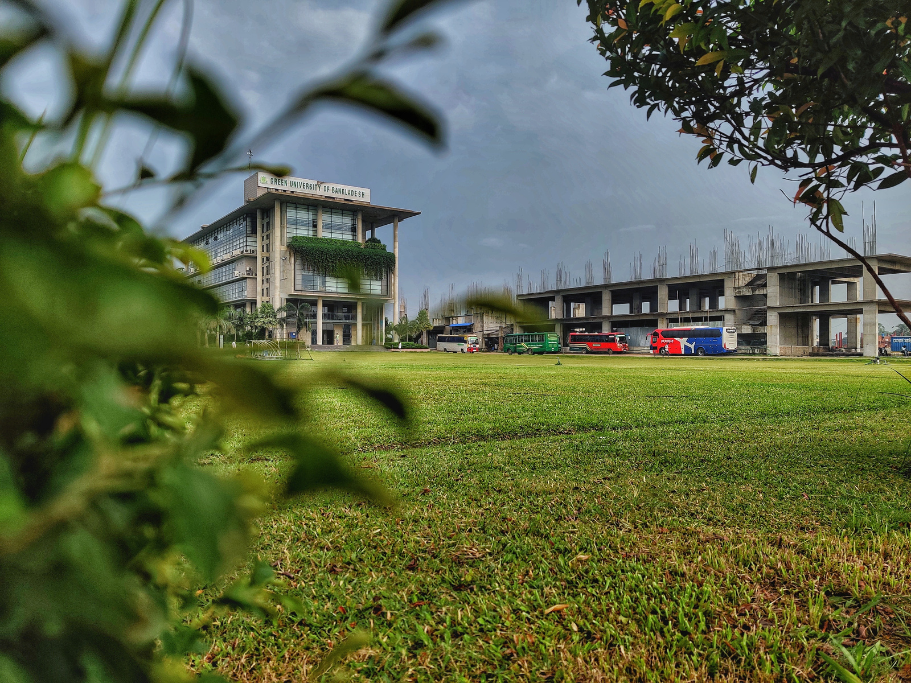

Green University of Bangladesh
Department Of Computer Science and Engineering(CSE)
Course Title: Database System Lab
Course Code: CSE 210 Section: 213 D10
Presented to
Mr. Tanoy Debnath
Lecturer, Dept. of CSE
Green University Of Bangladesh

Slide 2





Welcome To Our Presentation
Student Admission Management System

Slide 3


The Team
MD. MAHIM HOSSAIN
MD. ABU SAEID
221902082
221902092

Slide 4



Table of Content
Introduction & Motivation
Findings
Objectives
Methodology
ER Diagram
Implementation
Result Analysis
Tools & Techniques
Limitation & Future Scope
Conclusion

Slide 5

Introduction & Motivation
The Student Admission Management System is an all-encompassing web application crafted to simplify and streamline the complex student admissions process in educational institutions.
Why We're Doing This
Simplifying with Less Manual Work
Improving User Experience for Both Administrators and Applicants

Slide 6



Findings
Comparative analysis of admission systems
Lessons learned from implementing similar systems
Challenges and solutions in admission processes
User feedback on existing student management systems

Slide 7

Objectives
01
02
03
Automate student admission processes
Develop a user-friendly web application
Implement and manage the database using XAMPP server

Slide 8

Methodology
Admission
Apply
Home
Courses
About
Student
Contact
Signup
Online Apply
Admin

Slide 9

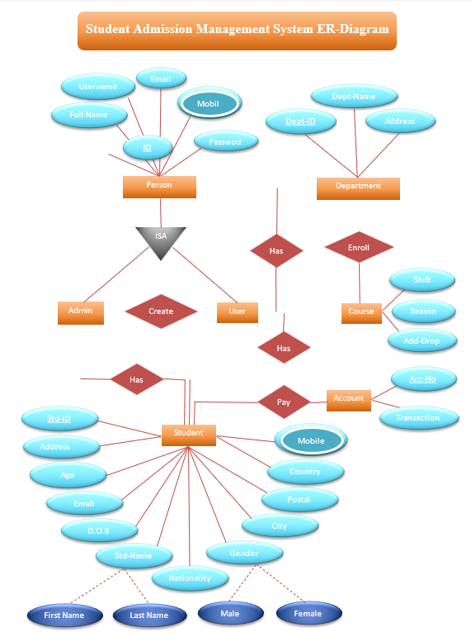
ER Diagram

Slide 10


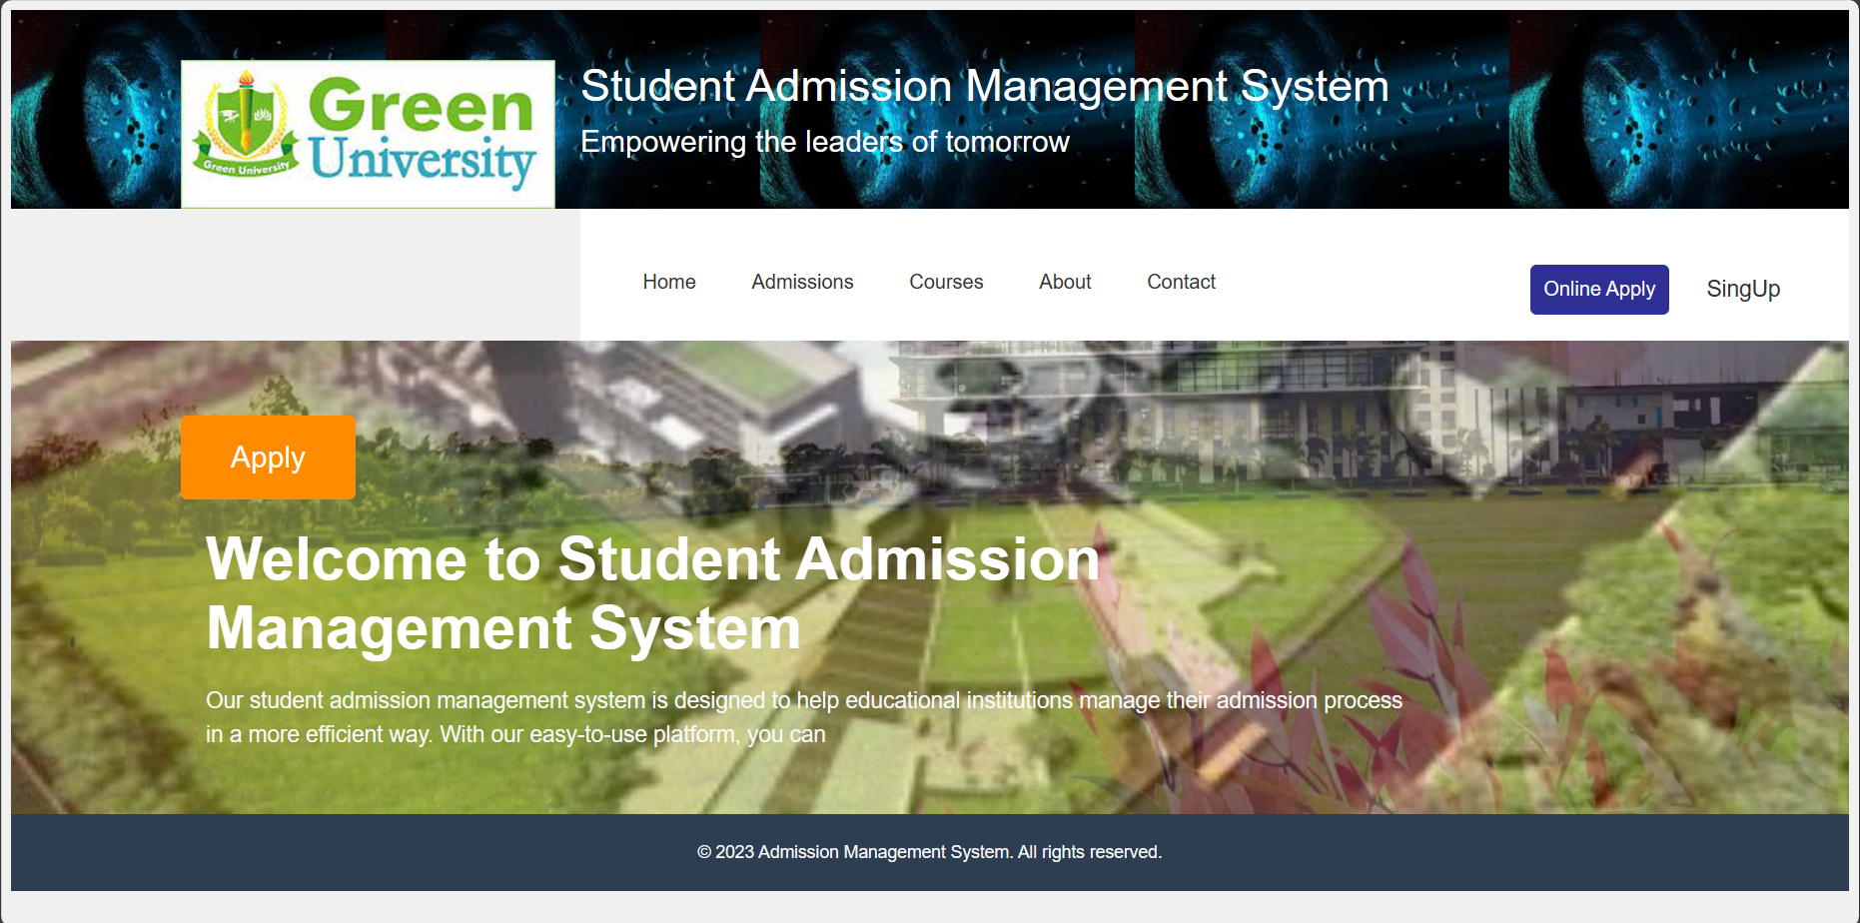

Implementation
Home

Slide 11
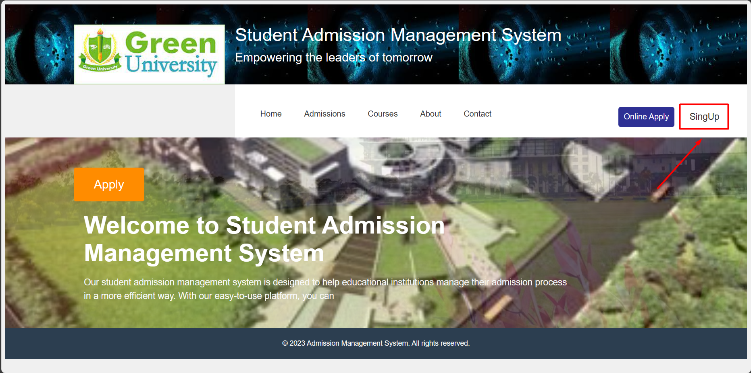

Implementation (Con.)
SignUp

Slide 12
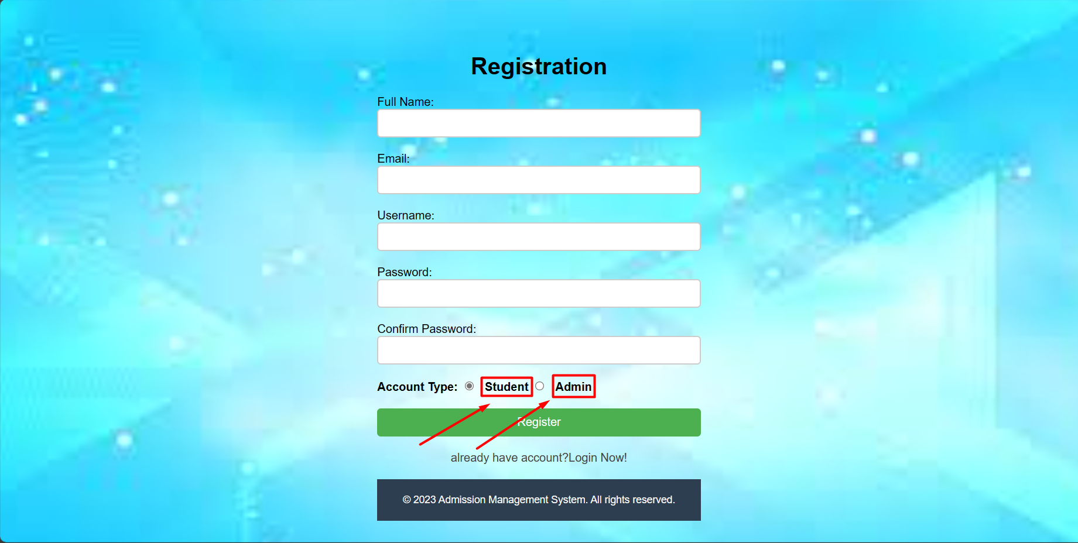

Implementation (Con.)
Registation

Slide 13
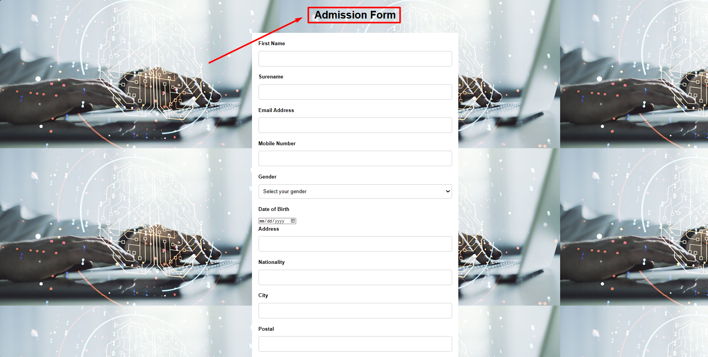

Implementation (Con.)
Admission Form

Slide 14

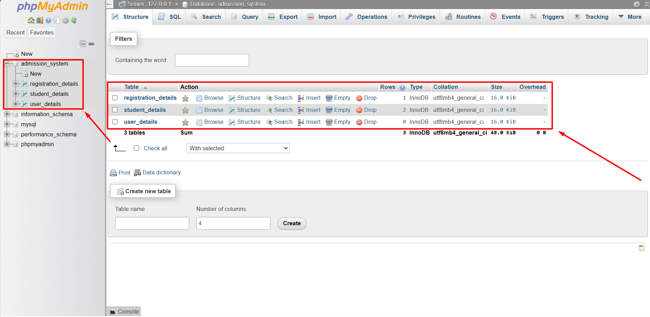

Result Analysis
Database

Slide 15
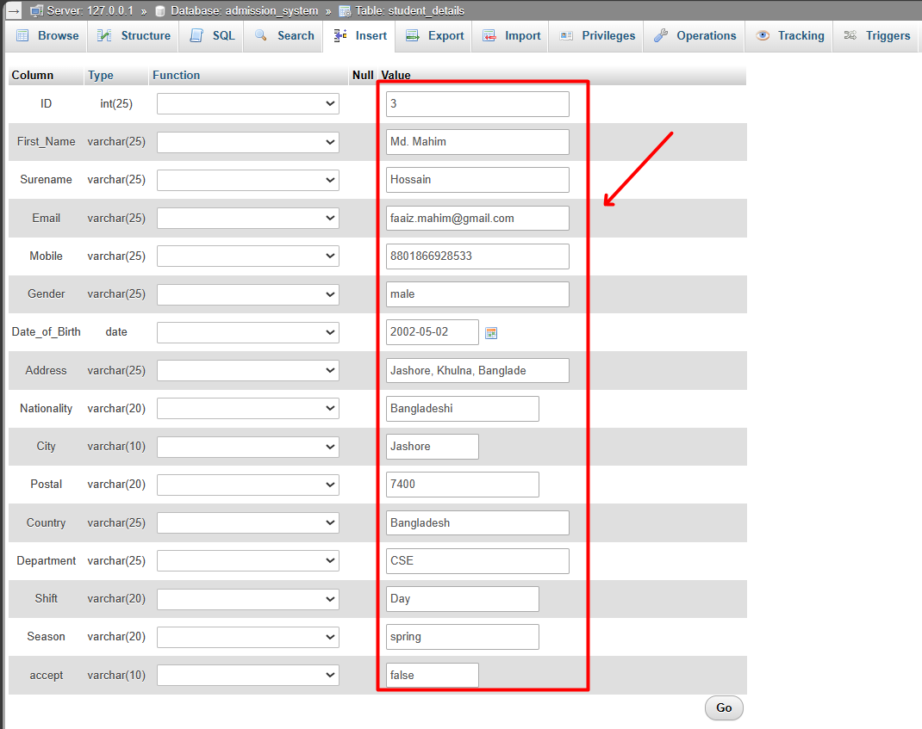

Result Analysis (Con.)
Database

Slide 16




Limitation
Advantage
Disadvantage
Advantages of Student Admission Management System
Dependency on Internet Connectivity
Improved Student Performance
Technical Difficulties
User-Friendly Interface
Cost Considerations
Customizable
Security Risks and Bias

Slide 17


Future Scope
Integration with Other University Systems
AI-Based Decision-Making
Mobile Application Development

Slide 18


Conclusion

Slide 19


Dynamite Panda
Thanks for Watching
Thanks everyone for being here – your presence means a lot!
Any Question, Just Ask don't be shy
Grateful for your presence! Thank you all!
Who's in team :
Jan 09, 2024

